Slide 1

Forecasting Pharma Bounce Rate
Project Title

Slide 2

Project Leadership
Sharat Manikonda
Director at Innodatatics and Sponsor
linkedin.com/in/sharat-chandra

Slide 3
Team Members
Name: Bhavya Bhagerathi
( https://www.linkedin.com/in/bhavya-b-575b32281/ )

Slide 4

Contents
Business objective
Business Constraints
Project Architecture
Data collection and details
Exploratory Data Analysis
Visualization
Modeling
Evaluation
Deployment
Notes:
Change

Slide 5
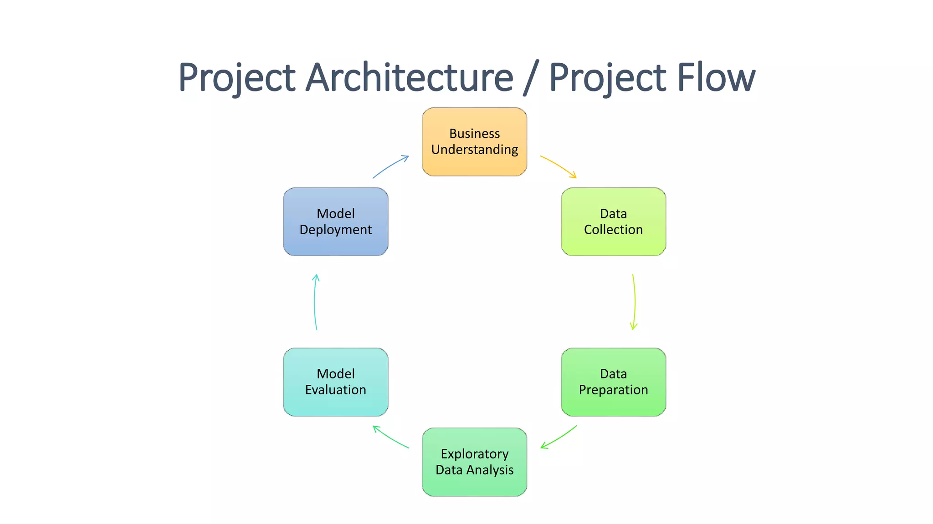
Project Overview and Scope

Slide 6
Business Problem
Predicting pharmaceutical bounce rates using time series analysis to optimize online engagement and marketing strategies.

Slide 7
Business Objective
The business objective is to leverage time series analysis to accurately forecast pharmaceutical bounce rates, enabling data-driven decisions for optimizing online engagement and enhancing marketing strategies in the pharmaceutical industry.

Slide 8
Constraints
Availability and Quality of Historical Data
External Factors Impacting Bounce Rates
Continuous Monitoring and Adaptation of Forecasting Model

Slide 9
CRISP-ML(Q) Methodology
There are six stages of CRISP-ML(Q) Methodology
1.Business and data understanding
2.Data preparation
3.Model building
4.Model evaluation
5.Model deployment
6.Monitoring and maintenance

Slide 10
Technical Stacks
Python Programming Language
Statsmodels Library for Seasonal Decomposition and Model Fitting
pmdarima Library for Auto ARIMA Modeling
Matplotlib for ACF and PACF Plots
Data Resampling for Monthly Segmentation
Model Evaluation using Mean Absolute Percentage Error (MAPE)
Persistence in Saving and Loading Trained Models

Slide 11
Data Collection and Understanding
Source: Gather pharmaceutical bounce rate data from relevant online platforms and channels.
Quality Check: Ensure data integrity, consistency, and accuracy through thorough validation processes.
Feature Selection: Identify key features affecting bounce rates, considering factors such as content type, user demographics, and promotional activities.
Temporal Segmentation: Resample data into monthly segments for effective time series analysis.
Exploratory Data Analysis (EDA): Gain insights into patterns, trends, and potential outliers within the dataset.
Domain Understanding: Collaborate with domain experts to contextualize data and account for industry-specific nuances.
Documentation: Document data sources, preprocessing steps, and initial observations for transparency and reproducibility.

Slide 12
Data Information
Type: Time series data on pharmaceutical bounce rates.
Granularity: Monthly segmentation for detailed analysis.
Features:
Bounce Rates
Content Type
User Demographics
Promotional Activities
Source: Online platforms and channels specific to the pharmaceutical industry.
Quality Assurance: Rigorous validation procedures to ensure data integrity.
Volume: Sufficient historical data for robust time series analysis.
Exploratory Insights: Initial exploration to identify patterns and outliers.
Collaboration: Ongoing collaboration with domain experts for context and relevance.

Slide 13
Data Dictionary
Date: The timestamp indicating the month of the recorded data.
Bounce Rate: The percentage of visitors who navigate away from the site after viewing only one page, representing user disengagement.
Content Type: Categorization of pharmaceutical content, such as articles, videos, or promotional material.
User Demographics:
Age Group: The age range of the user.
Gender: The gender of the user.
Promotional Activities:
Campaigns: Identification of specific marketing campaigns or promotions.

Slide 14
System Requirements
Hardware:
Adequate computing power for time series analysis and model training.
Storage capacity to accommodate historical and forecasted data.
Software:
Python (latest version) for code implementation. Jupyter Notebook for implementation.
Required libraries: Statsmodels, pmdarima, Matplotlib, and other relevant dependencies.
Data:
Access to a reliable dataset of pharmaceutical bounce rates with necessary features.
Monthly segmented data for accurate time series analysis.

Slide 15
System Requirements
Collaboration Tools:
Communication platforms for regular updates and discussions with stakeholders.
Version control system for tracking code changes and ensuring reproducibility.
Documentation:
Tools for documenting code, data preprocessing steps, and analysis results.
Security Measures:
Ensure data security and compliance with privacy regulations in handling pharmaceutical data.

Slide 16
Data Preprocessing
Duplicate Removal:
Identified and removed 26 duplicate entries to ensure data accuracy.
Handling Missing Values:
Checked for missing values and dropped them, ensuring a complete dataset.
Column Selection:
Removed unnecessary columns ('Typeofsales', 'Patient_ID') for streamlined analysis.
Data Type Conversion:
Converted the 'Dateofbill' column from object to datetime format for chronological sorting.
Notes:
Keep observations

Slide 17
Exploratory Data Analysis [EDA]
D-Tale Visualization:
Employed D-Tale for interactive visualizations, offering a comprehensive view of the dataset.
Explored various charts, histograms, and statistical summaries to understand data distributions and characteristics.
Top Drug Selection:
Investigated the distribution of pharmaceutical data to identify drugs with significant impact or high usage.
Conducted analysis on drug frequencies to determine the top drugs for further analysis.
Time Series Data Preparation:
Resampled the data at monthly intervals to transform the dataset into a time series format.
Sorted and indexed the data by date, preparing it for time series analysis.
Notes:
EDA is used for seeing what the data can tell us before the modeling task.
Change

Slide 18
Exploratory Data Analysis [EDA]
Statistical Summaries:
Calculated summary statistics such as mean, median, and standard deviation for key variables.
Utilized box plots and other graphical tools to identify potential outliers and assess data variability.
Correlation Analysis:
Investigated relationships between variables, exploring correlations to identify potential patterns.
Visualized correlations through heatmaps and scatter plots for enhanced interpretation.
Data Trends and Patterns:
Applied trend analysis to identify overarching patterns in pharmaceutical bounce rates over time.
Examined seasonality in the data using decomposition techniques to understand cyclical trends.
Notes:
EDA is used for seeing what the data can tell us before the modeling task.
Change

Slide 19
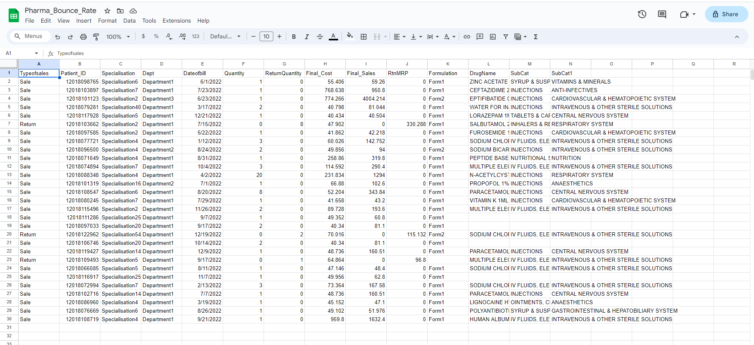
Data Visualization
Dataset Viewing
Notes:
Add graphical

Slide 20
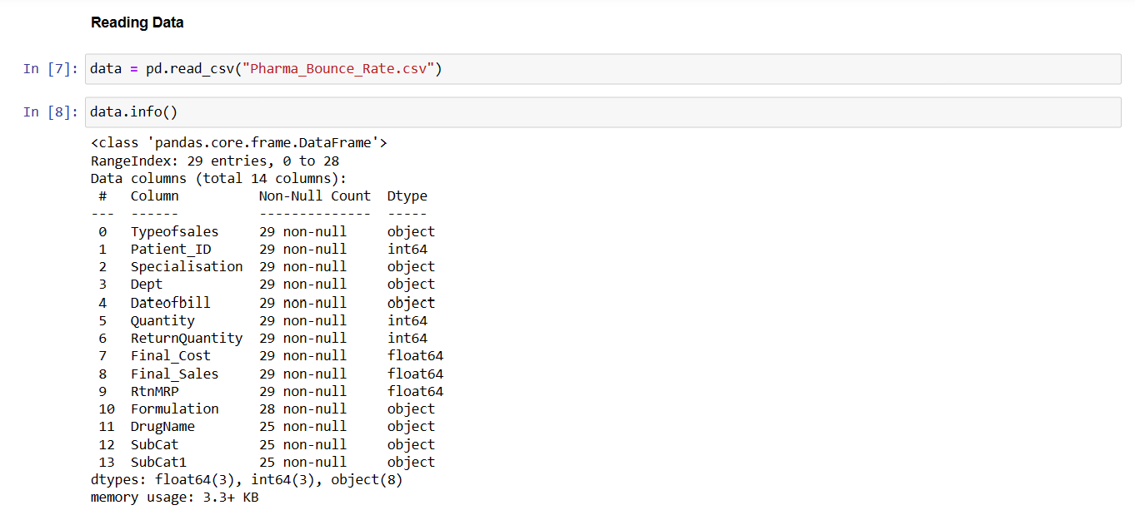
Data Visualization
Dataset Information
Notes:
Add graphical

Slide 21
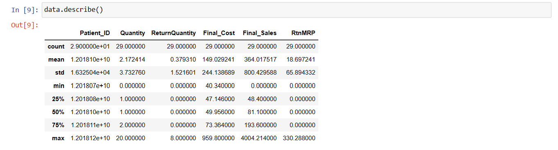
Data Visualization
Dataset Description
Notes:
Add graphical

Slide 22
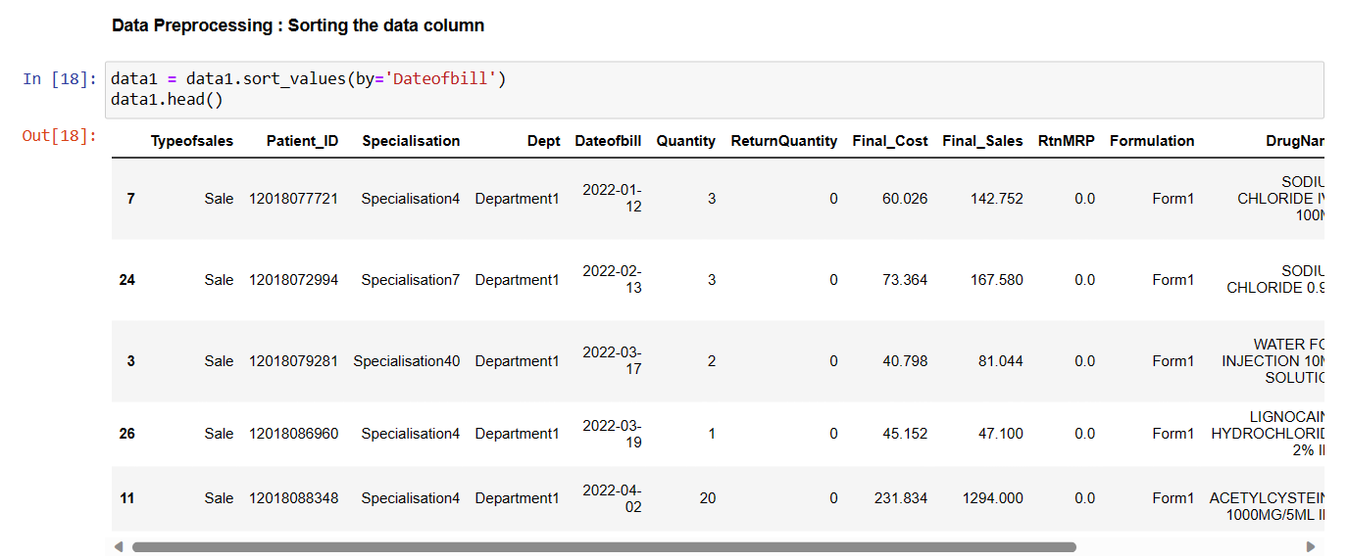
Data Visualization
Sorting Data
Notes:
Add graphical

Slide 23
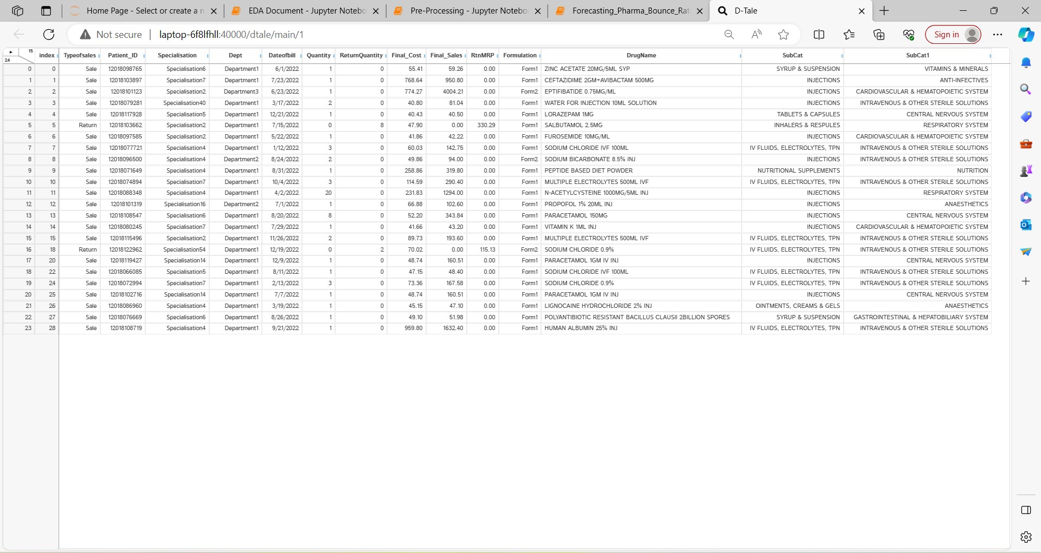
Data Visualization
D-Tale Interactive Visualizations:
Leveraged D-Tale for interactive visualizations, providing a dynamic exploration of data patterns.
Utilized charts, histograms, and statistical summaries for a holistic view of the dataset.
Notes:
Add graphical

Slide 24
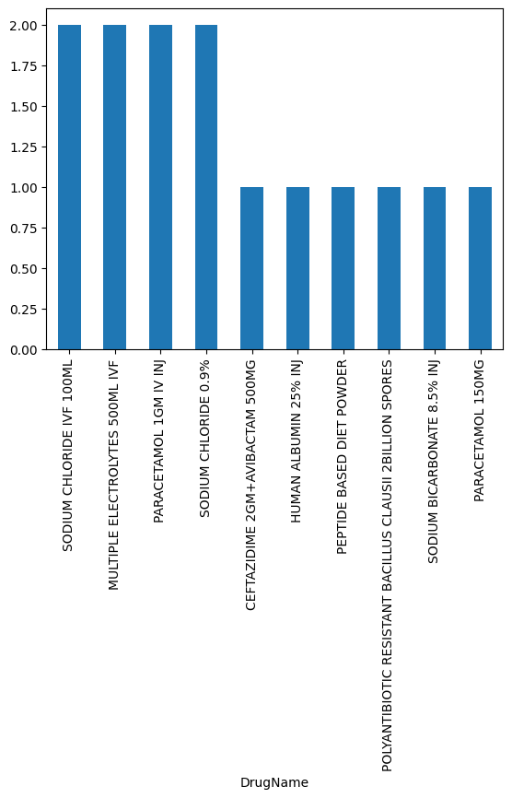
Data Visualization
Top Drug Distribution:
Plotted bar charts to visualize the distribution of pharmaceutical data and identify the top drugs.
Presented drug frequencies through graphical representations for clear insights.
Notes:
Add graphical

Slide 25
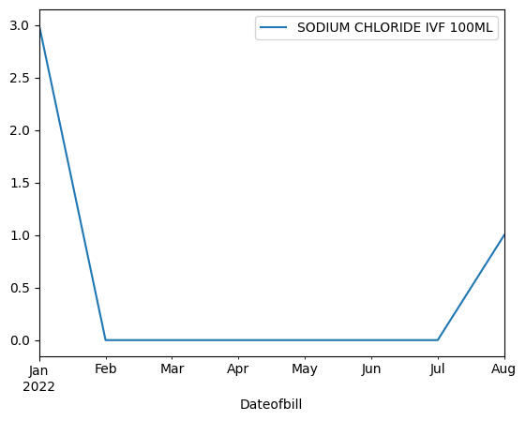
Data Visualization
Time Series Plots:
Generated time series plots for each top drug to visualize trends and fluctuations over time.
Utilized line plots to depict the monthly variations in pharmaceutical bounce rates.
Notes:
Add graphical

Slide 26
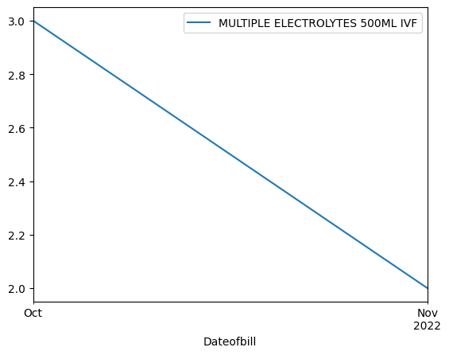
Data Visualization
Time Series Plots:
Generated time series plots for each top drug to visualize trends and fluctuations over time.
Utilized line plots to depict the monthly variations in pharmaceutical bounce rates.
Notes:
Add graphical

Slide 27
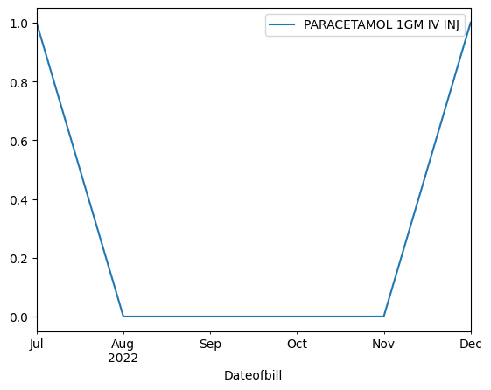
Data Visualization
Time Series Plots:
Generated time series plots for each top drug to visualize trends and fluctuations over time.
Utilized line plots to depict the monthly variations in pharmaceutical bounce rates.
Notes:
Add graphical

Slide 28
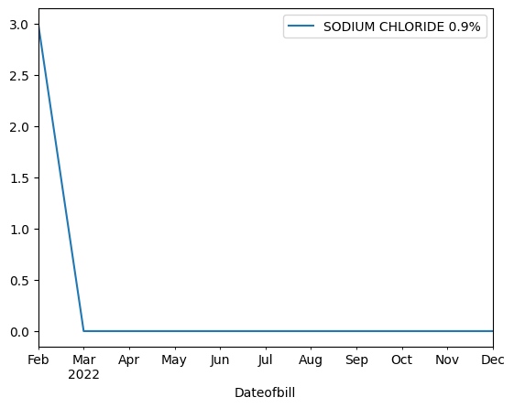
Data Visualization
Time Series Plots:
Generated time series plots for each top drug to visualize trends and fluctuations over time.
Utilized line plots to depict the monthly variations in pharmaceutical bounce rates.
Notes:
Add graphical

Slide 29
Data Visualization
Statistical Visualizations:
Created box plots to visually assess the spread and central tendency of key variables.
Employed scatter plots for correlation analysis, providing a graphical representation of variable relationships.
Decomposition Plots:
Employed seasonal decomposition plots to visualize the trend, seasonality, and residuals of time series data.
Used additive decomposition for a clearer understanding of temporal components.
Correlation Heatmaps:
Constructed heatmaps to illustrate correlations between variables, highlighting potential patterns and relationships.
Summary Charts:
Developed summary charts presenting statistical measures like mean, median, and standard deviation.
Incorporated visually appealing charts for effective communication of key data characteristics.
Notes:
Add graphical

Slide 30
Model Building
Steps involved in model building
Data Preparation:
Clean and preprocess the time series data, handling duplicates, missing values, and selecting relevant features.
Convert the 'Dateofbill' column to datetime format and sort the data chronologically.
Top Drug Selection:
Identify the top pharmaceutical drugs based on distribution analysis for focused forecasting.
Time Series Analysis:
Resample the data at monthly intervals to create a time series for each top drug.
Explore and visualize time series patterns using tools like D-Tale, seasonality decomposition, and autocorrelation plots.
Notes:
classification is the task of predicting a discrete class label. Regression is the task of predicting a continuous quantity.
What is classification techniques in machine learning?
The Classification algorithm is a Supervised Learning technique that is used to identify the category of new observations on the basis of training data. In Classification, a program learns from the given dataset or observations and then classifies new observation into several classes or groups.
What is regression techniques in machine learning?
Regression is a technique for investigating the relationship between independent variables or features and a dependent variable or outcome. It's used as a method for predictive modeling in machine learning, in which an algorithm is used to predict continuous outcomes.

Slide 31
Model Building
Steps involved in model building
4. Auto ARIMA Model Selection:
Utilize the pmdarima library to automatically select the best ARIMA model for each drug based on the Akaike Information Criterion (AIC).
Apply the selected ARIMA models to the time series data for forecasting.
5. Model Training:
Train the ARIMA models on historical data to learn patterns, trends, and seasonality.
6. Model Evaluation:
Evaluate the performance of the trained models using appropriate metrics such as Mean Absolute Percentage Error (MAPE).
Adjust model hyperparameters or structures if necessary for improved accuracy.
Notes:
classification is the task of predicting a discrete class label. Regression is the task of predicting a continuous quantity.
What is classification techniques in machine learning?
The Classification algorithm is a Supervised Learning technique that is used to identify the category of new observations on the basis of training data. In Classification, a program learns from the given dataset or observations and then classifies new observation into several classes or groups.
What is regression techniques in machine learning?
Regression is a technique for investigating the relationship between independent variables or features and a dependent variable or outcome. It's used as a method for predictive modeling in machine learning, in which an algorithm is used to predict continuous outcomes.

Slide 32
Model Building
Steps involved in model building
7. Final Forecasting:
Use the trained ARIMA models to make future predictions for the next 12 months for each top drug.
8. Saving and Loading Models:
a. Save the trained ARIMA models for each drug to ensure reusability and easy deployment.
Load the saved models for making future predictions without retraining.
9. Continuous Monitoring and Refinement:
Regularly monitor the model performance and update as needed to adapt to changing user behaviors or market dynamics.
Refine the models based on feedback, new data, or improved forecasting techniques.
10. Documentation:
Document the entire model building process, including data preprocessing steps, model selection criteria, and evaluation metrics.
Provide transparency for future analysis and collaboration.
Notes:
classification is the task of predicting a discrete class label. Regression is the task of predicting a continuous quantity.
What is classification techniques in machine learning?
The Classification algorithm is a Supervised Learning technique that is used to identify the category of new observations on the basis of training data. In Classification, a program learns from the given dataset or observations and then classifies new observation into several classes or groups.
What is regression techniques in machine learning?
Regression is a technique for investigating the relationship between independent variables or features and a dependent variable or outcome. It's used as a method for predictive modeling in machine learning, in which an algorithm is used to predict continuous outcomes.

Slide 33
Model Accuracy Comparison
MAPE Interpretation:
MAPE is expressed as a percentage, representing the average percentage difference between the predicted and actual values.
Lower MAPE values indicate higher accuracy, with 0% representing a perfect match between predictions and actual values.
Benchmarking:
It's essential to establish a benchmark or baseline MAPE based on historical data or naive forecasting methods.
The model's MAPE should be compared to this benchmark to assess its relative performance.
Acceptable Range:
Acceptable MAPE values vary across industries and applications. In some cases, a MAPE below 10% might be considered excellent, while in others, a range of 10-20% may be acceptable.
Consideration for Outliers:
MAPE can be sensitive to outliers, especially in datasets with extreme values.
It's crucial to understand the impact of outliers on model accuracy and consider robust metrics if necessary.

Slide 34
Model Accuracy
Continuous Monitoring:
Model accuracy is not a static measure; it should be monitored regularly, especially as new data becomes available.
Periodic reevaluation and potential model retraining can improve accuracy over time.
Domain-Specific Considerations:
Consider domain-specific factors that might influence the interpretation of model accuracy.
For example, in pharmaceutical forecasting, the impact of external events or regulatory changes could affect accuracy.
Visualization:
Visualize the predicted values against actual values over time to gain insights into model performance.
Time series plots, residual plots, and forecast vs. actual plots can provide a comprehensive view.
Model Comparison:
If multiple models are considered, compare their MAPE values to identify the most accurate model.
Use statistical tests or additional metrics for a comprehensive evaluation.

Slide 35
Model Deployment - Strategy
Infrastructure Setup:
Determine the appropriate infrastructure, considering tools like D-Tale for visualizations and hosting services for model deployment.
API Development:
If applicable, develop APIs for accessing forecasting results programmatically, ensuring smooth integration with existing systems.
Visualization Integration:
Integrate time series plots and visualizations into user interfaces, providing an intuitive display of forecasted data.
Monitoring & Model Versions:
Implement monitoring for the deployed ARIMA models, track accuracy, and version the models to manage improvements effectively.
Security & Documentation:
Apply security measures for data protection, and document the model deployment process for transparency and user understanding.

Slide 36
Challenges
Here are the key challenges:
Data Quality:
Ensuring accuracy and completeness in pharmaceutical bounce rate data.
Seasonality Complexity:
Addressing intricate seasonal patterns in bounce rates for accurate forecasts.
External Factors:
Accounting for external influences, like regulatory changes, impacting bounce rates.
Model Selection:
Choosing an effective time series forecasting model for accurate predictions.
Dynamic User Behavior:
Adapting to changes in user behavior and external factors affecting engagement.
These challenges focus on the core aspects that significantly impact the accuracy and reliability of pharmaceutical bounce rate forecasts.

Slide 37
Future Scopes
The future scope for pharmaceutical bounce rate forecasting presents exciting possibilities for advancements in predictive analytics and data-driven decision-making. Integration of machine learning algorithms, such as deep learning models, can enhance the accuracy of forecasts by capturing intricate patterns and dependencies in the data. Moreover, the incorporation of real-time data streams and continuous monitoring mechanisms can enable more adaptive and responsive forecasting systems. Additionally, exploring the potential impact of emerging technologies like blockchain for data security and transparency could further revolutionize the pharmaceutical forecasting landscape. As the field evolves, collaborations between data scientists, domain experts, and technology innovators hold the potential to unlock new insights, improve model robustness, and contribute to more informed strategic planning in the pharmaceutical industry.

Slide 38
THANK YOU

